Slide 1

The Orr-Sommerfeld Equation
A Numerical Approach to Fluid Stability
Seyed Mohammad Amin Hosseini
Prof.S.Salman Nourazar
Hydrodynamics Instability

Slide 2
Agenda
Introduction
Problem Statement
Numerical Approach
Results
Future works

Slide 3
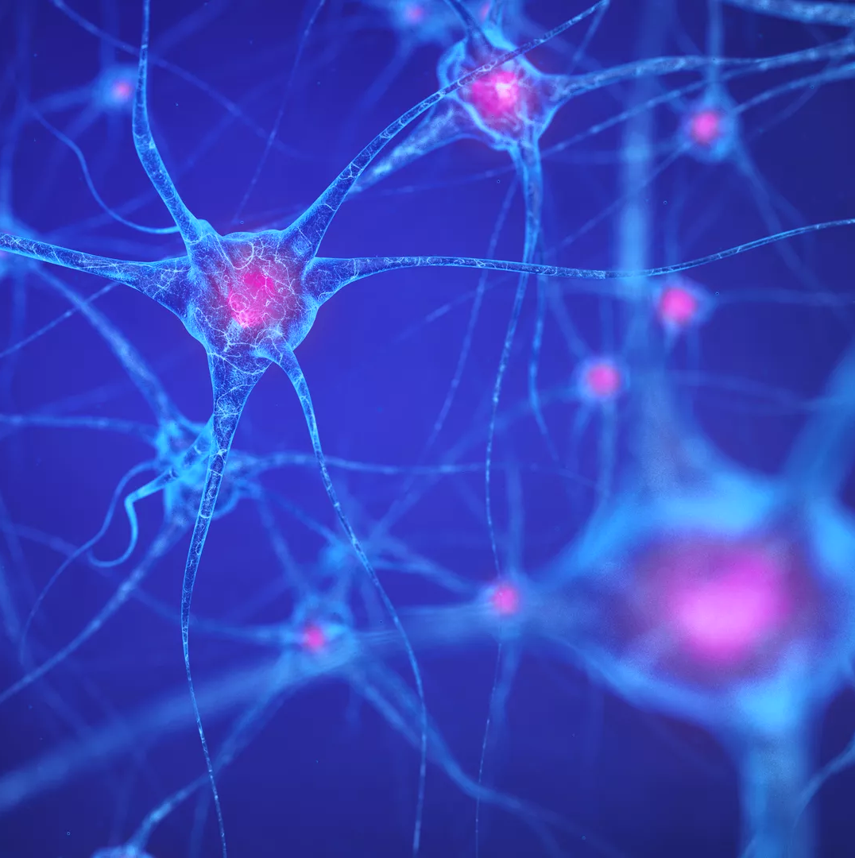
Introduction

Slide 4
Introduction
The Orr-Sommerfeld equation describes the linear stability of parallel shear flows, such as Poiseuille and Couette flow.
This equation helps determine whether small perturbations in the flow will decay (stable) or grow (unstable), leading to turbulence.
Understanding flow stability is essential in engineering applications, including aerodynamics, pipeline flow, and industrial fluid transport.
The objective of this study is to solve the Orr-Sommerfeld equation numerically using the Finite Difference Method (FDM) and analyze stability characteristics at different Reynolds numbers.

Slide 5

Problem Statement

Slide 6


Mathematical Formulation
The Orr-Sommerfeld equation is derived from the Navier-Stokes equations for incompressible fluid flow with small perturbations.
The equation is given by:
$$\frac{1}{iκRe}{\left[\frac{d^{2}}{dy^{2}}−κ^{2}\right]}^{2}v=\left(U−c\right)\left(\frac{d^{2}}{dy^{2}}−κ^{2}\right)v−U^{′′}v$$
And the B.C. of :
$$v=v^{′}=0 @ y=−1,1$$
$c=c_{r}+ic_{i}$ is the complex wave speed

Slide 7
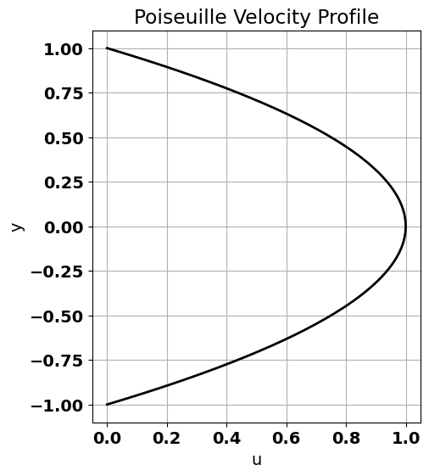

Problem Statement
The imaginary part of determines stability:
If $c_{i}<0$ disturbances decay (stable flow).
If $c_{i}>0$disturbances grow (unstable flow leading to transition to turbulence).
In this research we worked on Poiseuille Flow Profile in which the velocity profile :
$$U=1−y^{2}$$
Grid discretization from $y=−1$ to $y=1$

Slide 8
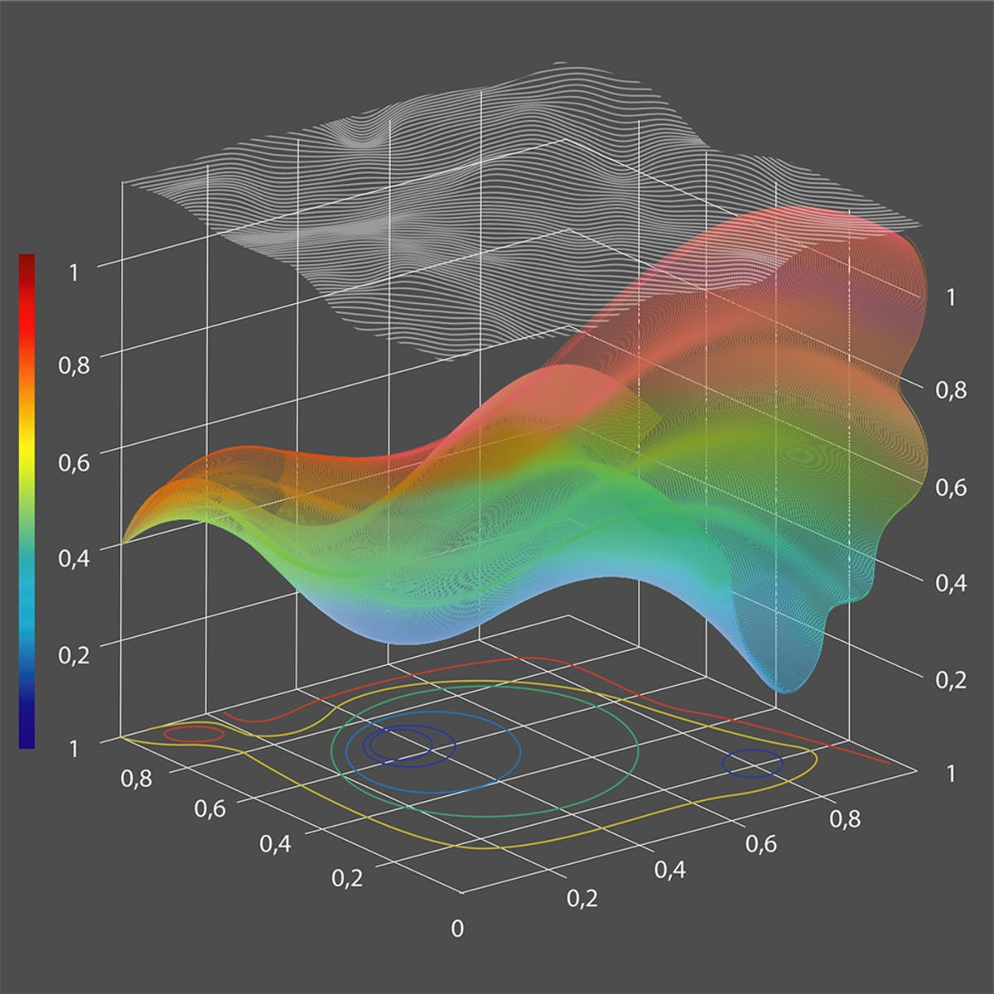
Numerical Approach

Slide 9
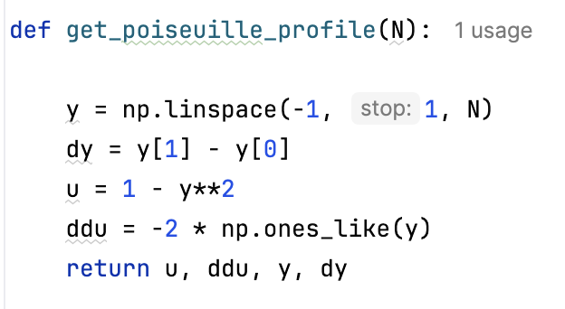

Code Structure
This function generates the parabolic velocity profile $U=1−y^{2}$ and its second derivative $U^{′′}=−2$
Channel domain: y = -1 to 1
N is the Number of grid points which is 201
Grid spacing
Parabolic velocity profile
Second derivative

Slide 10
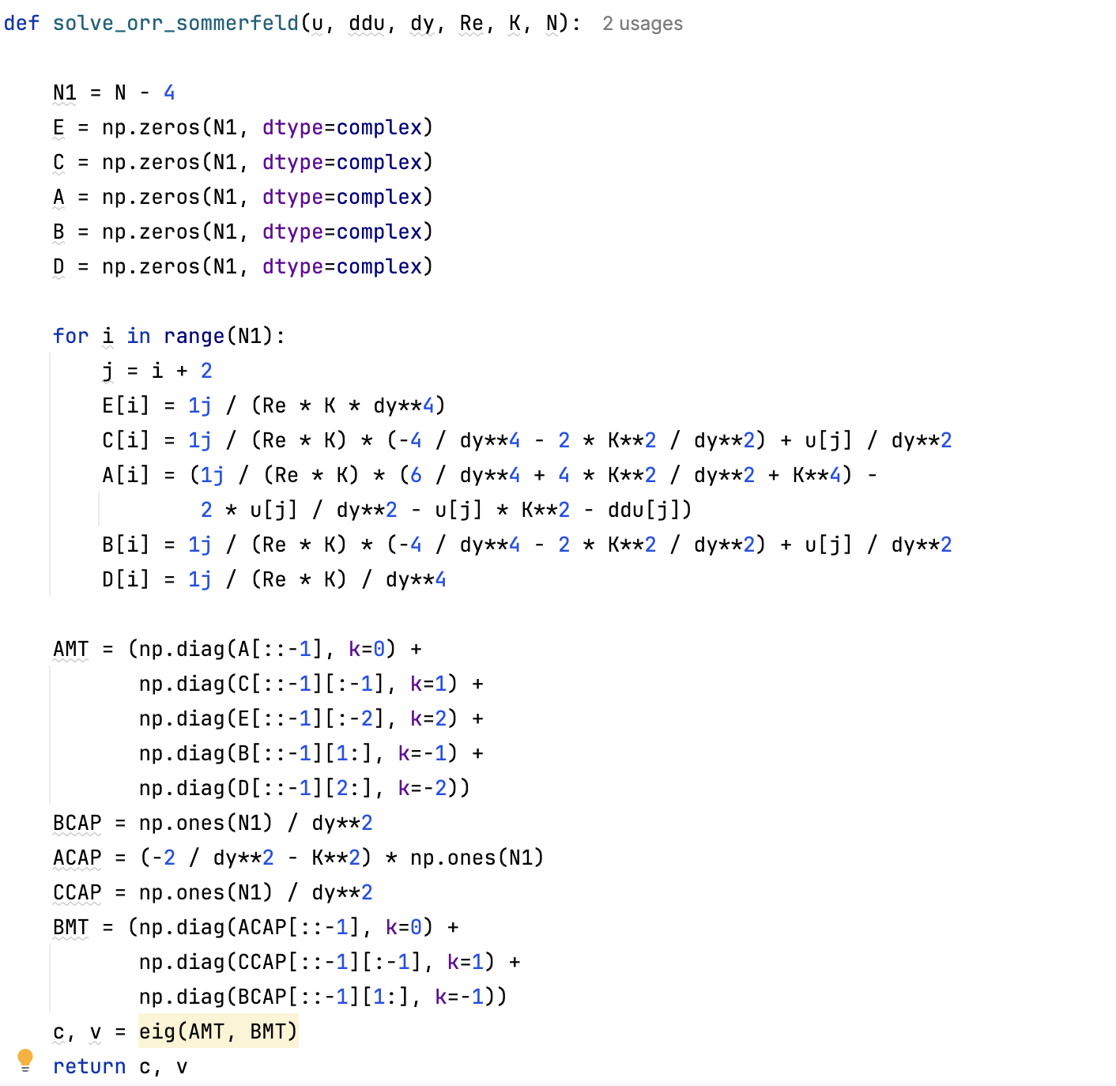
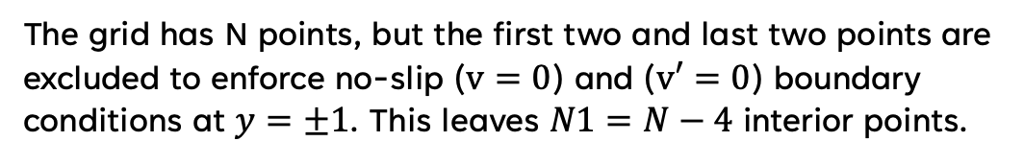
Code Structure
This function is the core of your implementation, as it numerically solves the Orr-Sommerfeld equation using the Finite Difference Method (FDM).
The grid has N points, but the first two and last two points are excluded to enforce no-slip ($v=0$) and ($v′=0$) boundary conditions at $y=±1$. This leaves $N1​=N−4$ interior points.

Slide 11
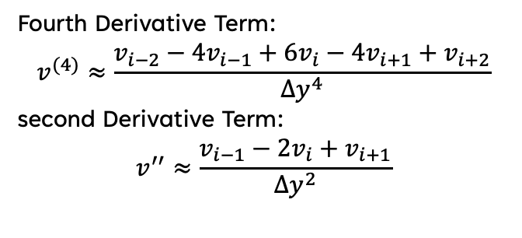
Code Structure
These arrays will hold the finite difference coefficients
Each term represents a discretization of the Orr-Sommerfeld equation
Fourth Derivative Term:
$$v^{(4)}≈\frac{v_{i−2}−4v_{i−1}+6v_{i}−4v_{i+1}+v_{i+2}}{Δy^{4}}$$
second Derivative Term:
$$v^{′′}≈\frac{v_{i−1}−2v_{i}+v_{i+1}}{Δy^{2}}$$
This constructs a pentadiagonal matrix

Slide 12
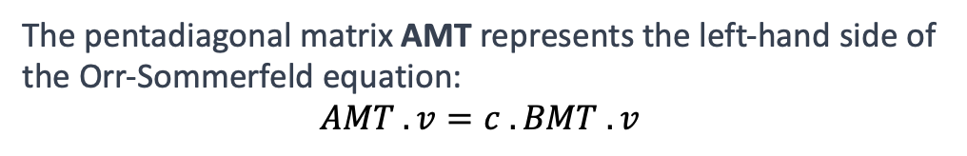
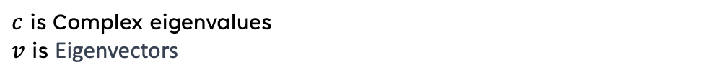
Code Structure
The pentadiagonal matrix AMT represents the left-hand side of the Orr-Sommerfeld equation:
$$AMT . v=c . BMT . v$$
The tridiagonal matrix BMT represents the right-hand side of the Orr-Sommerfeld equation.
The eigenvalues and eigenvectors are computed
$c$ is Complex eigenvalues
$v$ is Eigenvectors

Slide 13

Results

Slide 14
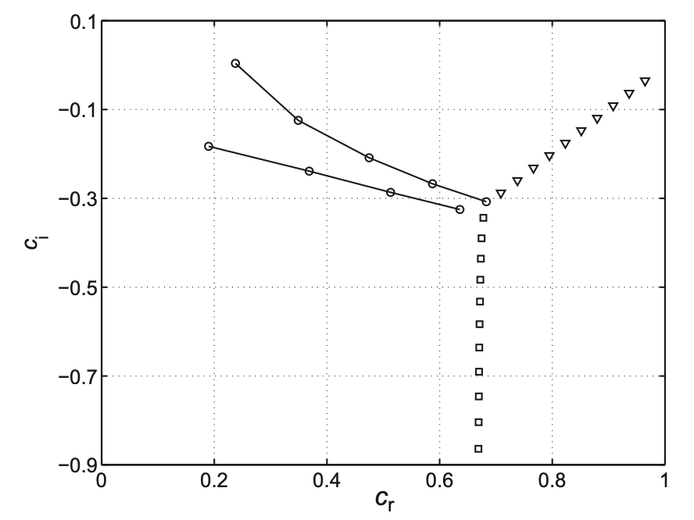
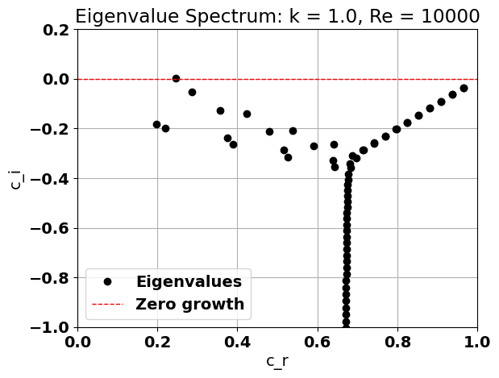

Eigenvalue Spectrum
These plots are Eigenvalue Spectrum for $κ=1.0 , Re=10000$
[1] Theory and Computation of Hydrodynamic Stability - W.O. criminale

Slide 15
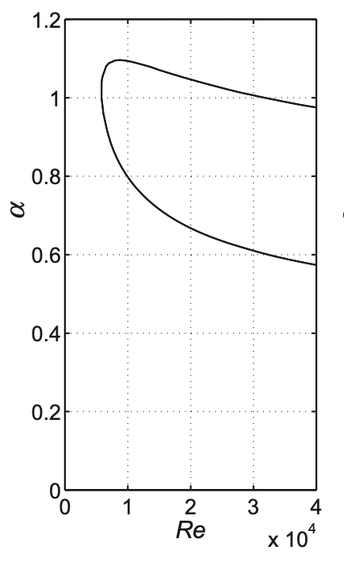
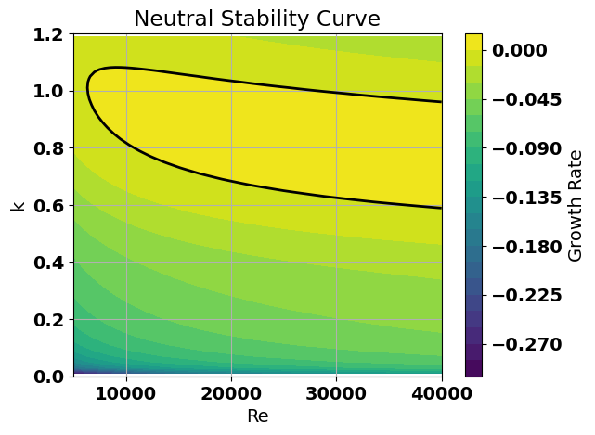

Results
The black contour line represents the neutral stability curve, where disturbances neither grow nor decay ($c_{i}=0$). Inside the enclosed region, $c_{i}>0$, meaning the flow is unstable, while outside it, the flow remains stable.

Slide 16

Future Work

Slide 17
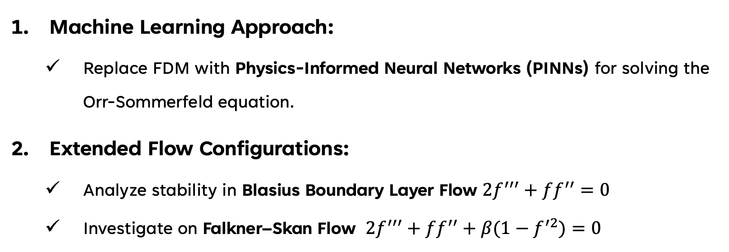
Future Work
Machine Learning Approach:
Replace FDM with Physics-Informed Neural Networks (PINNs) for solving the Orr-Sommerfeld equation.
Extended Flow Configurations:
Analyze stability in Blasius Boundary Layer Flow $2f^{′′′}+ff^{′′}=0$
Investigate on Falkner–Skan Flow $2f^{′′′}+ff^{′′}+β(1−f^{′2})=0$

Slide 18
Thank you
Seyed Mohammad Amin Hosseini
09934995672
Amin.hosseini1@aut.ac.ir

